Slide 2
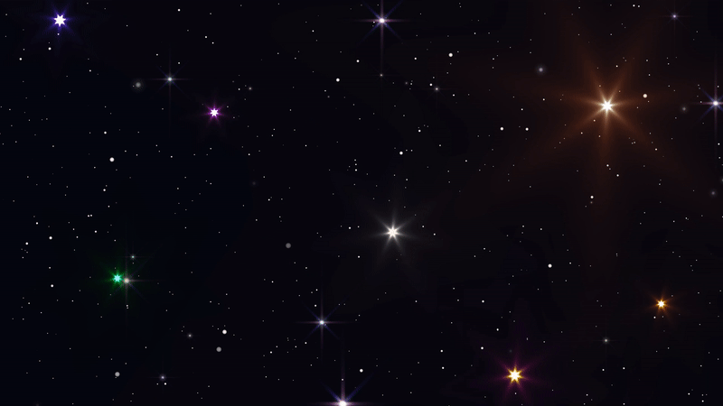

TWINKLING OF STARS
Why do stars twinkle?
Stars are point source of light

Slide 3
TWINKLING OF STARS
Light Year
Distance travelled by light in one year
6 trillion miles

Slide 4
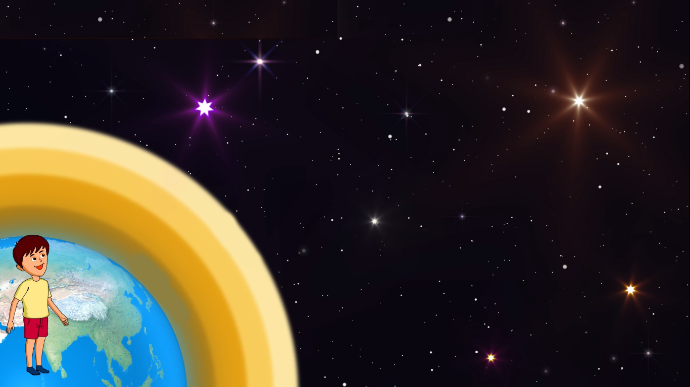

TWINKLING OF STARS
Stars are self luminous and can be seen at night in the absence of sunlight.
They appear to be point sources because of their being at a very large distance from us.
Rarer
The apparent position of the star keeps changing a bit. This is because of the motion of atmospheric air and changing air density and temperature.
Denser
Because of this, the refractive index of air keeps changing continuously because of this change, the position and brightness of the star keep changing continuously and the star appears to be twinkling.

Slide 5
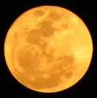
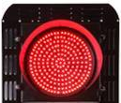

Why planets do not twinkle ?
Planet is nearer to the earth compared to stars
So planets can be considered as collection of large number
of point sources
Planets are much closer to us as compared to stars.
The layer which is away from the earth is rarer
They, therefore, do not appear as point sources but appear as collection of point.
The layer which is closest to the earth is denser
Rarer
Because of changes in atmospheric refractive index the position as well as the brightness of individual point source changes.
Denser
The average position and total average brightness remains unchanged and planets do not twinkle.

Slide 6
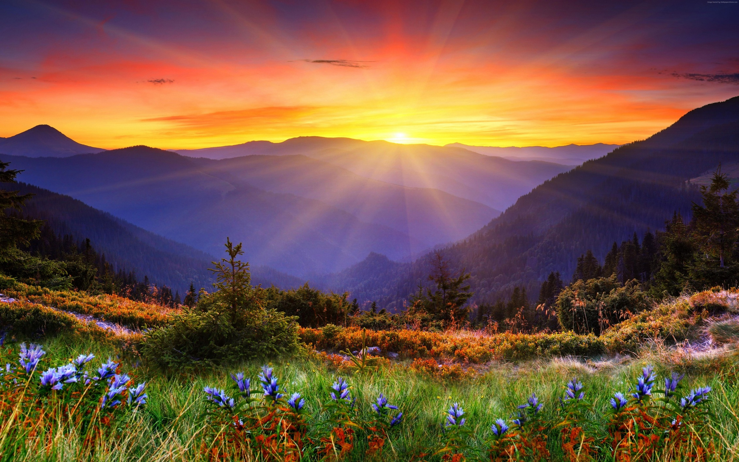
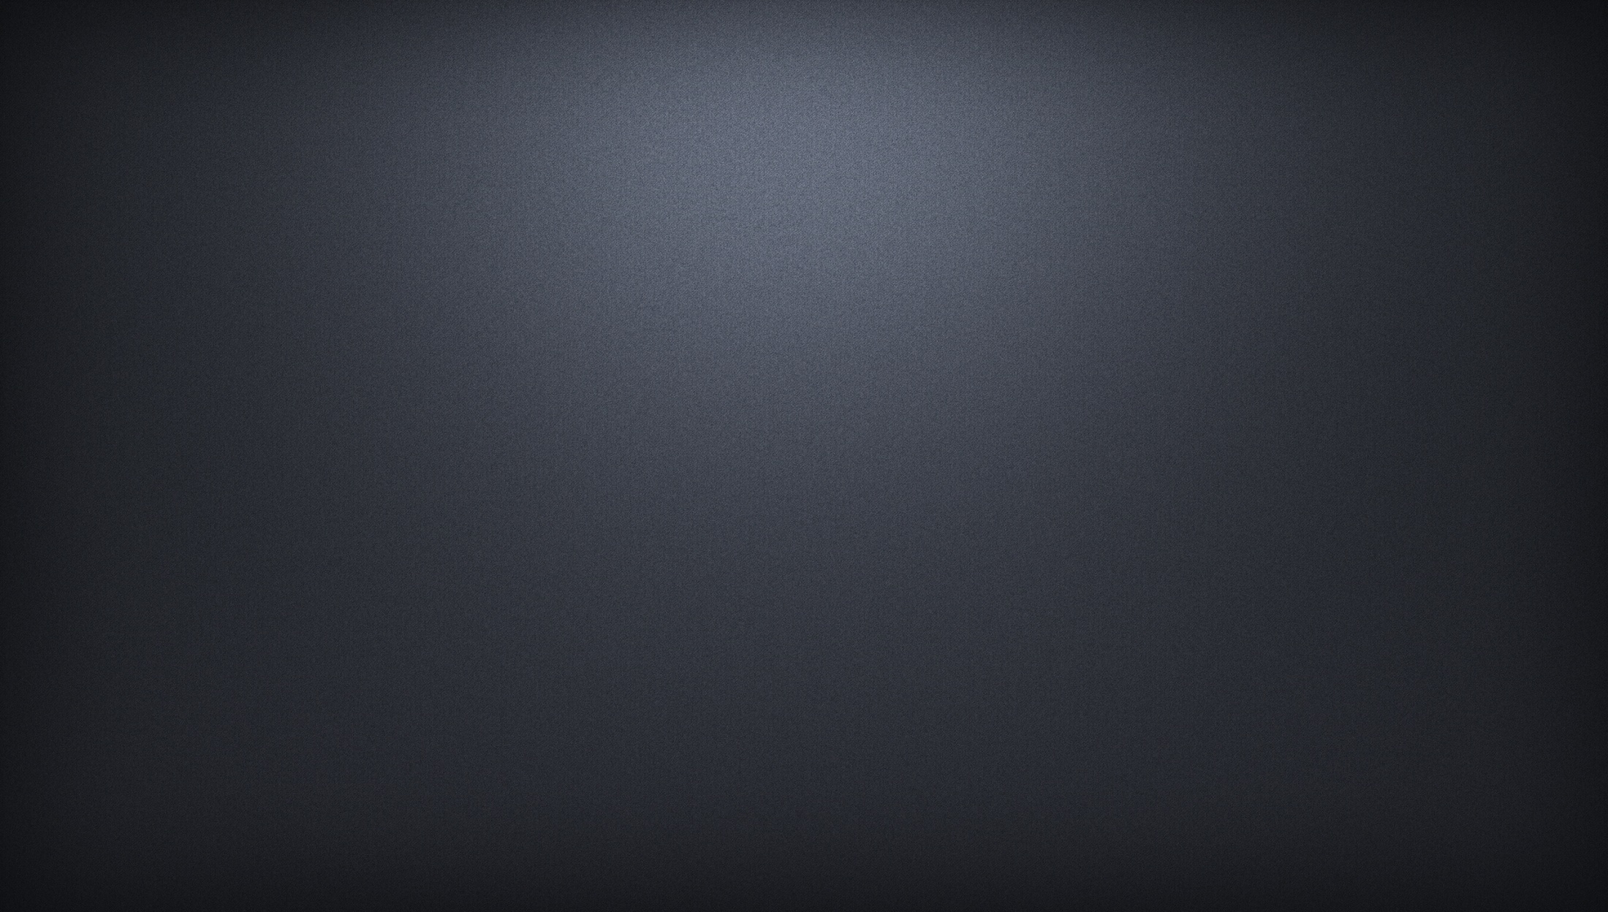
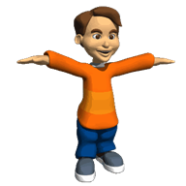
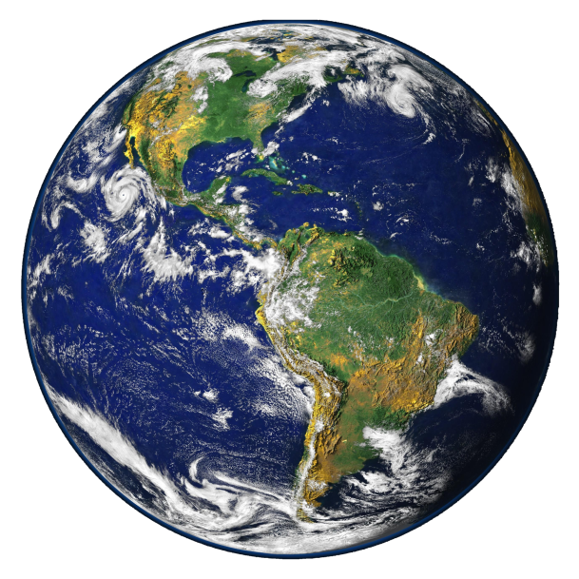
ADVANCE SUNRISE
The sun appears to rise two minutes earlier.
Apparent sun
Horizon
Rising Sun

Slide 7
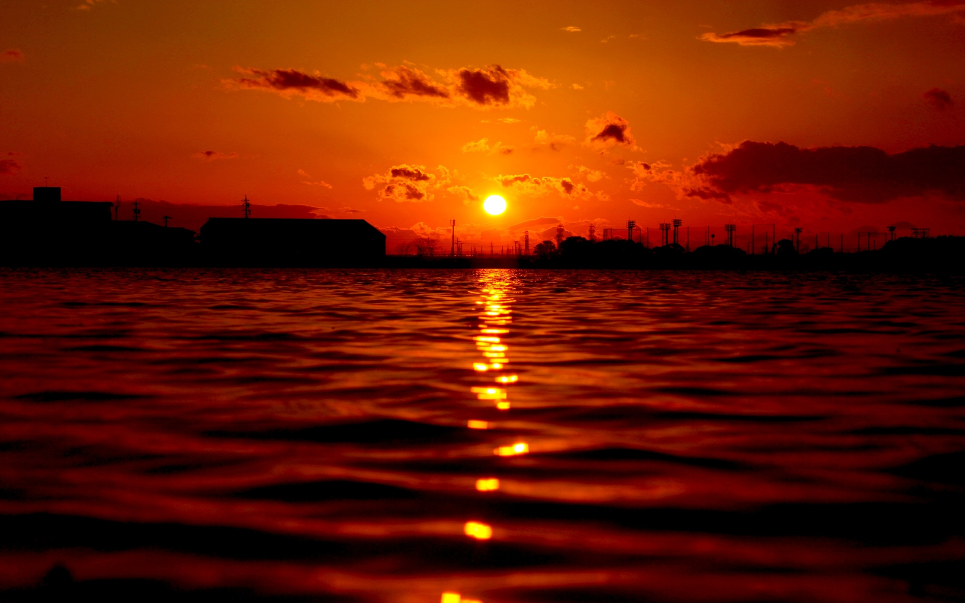
DELAYED SUNSET
The sun appears to set two minutes late.
Apparent sun
Horizon
Setting Sun

Slide 8


SCATTERING OF LIGHT
Regular reflection
Irregular reflection
i = r
i = r
r₁ = r₂ = r₃
r₁ ≠ r₂ ≠ r₃
i₁ = i₂ = i₃
i₁ ≠ i₂ ≠ i₃
i₁
r₁
i₂
r₂
i₃
r₃
r₂
i₁
i₂
i₃
r₃
r₁

Slide 9
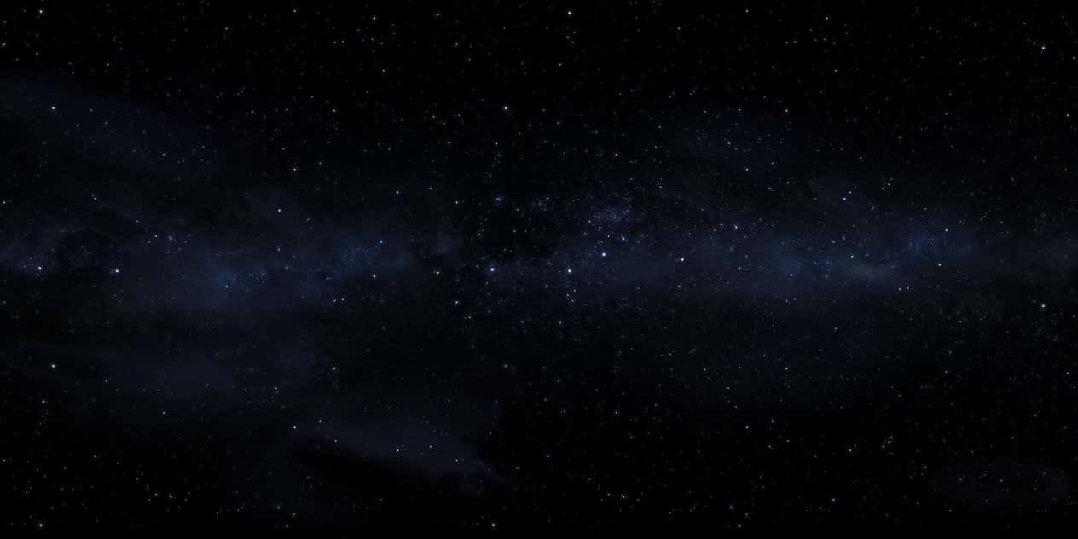

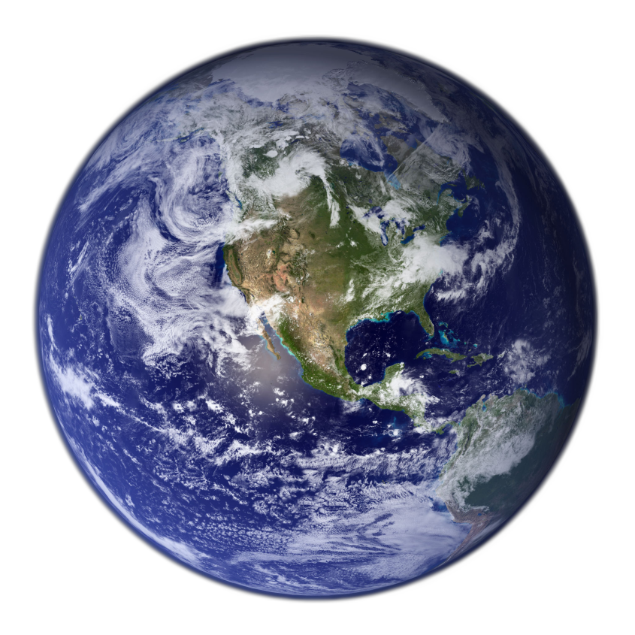
Irregular surface
Scattering is the process of absorption and then re-emission of light energy.

Slide 10

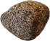
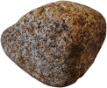
Factors affecting scattering of light
Wavelength
Size of particle
Red
λ_{r} = 8000Å
Smaller particle
Orange
Yellow
Green
Big
particle
Blue
Indigo
Violet
λ_{v} = 4000Å
Very big
particle
Violet light is scattered nearly 16 times more than the red light.

Slide 11
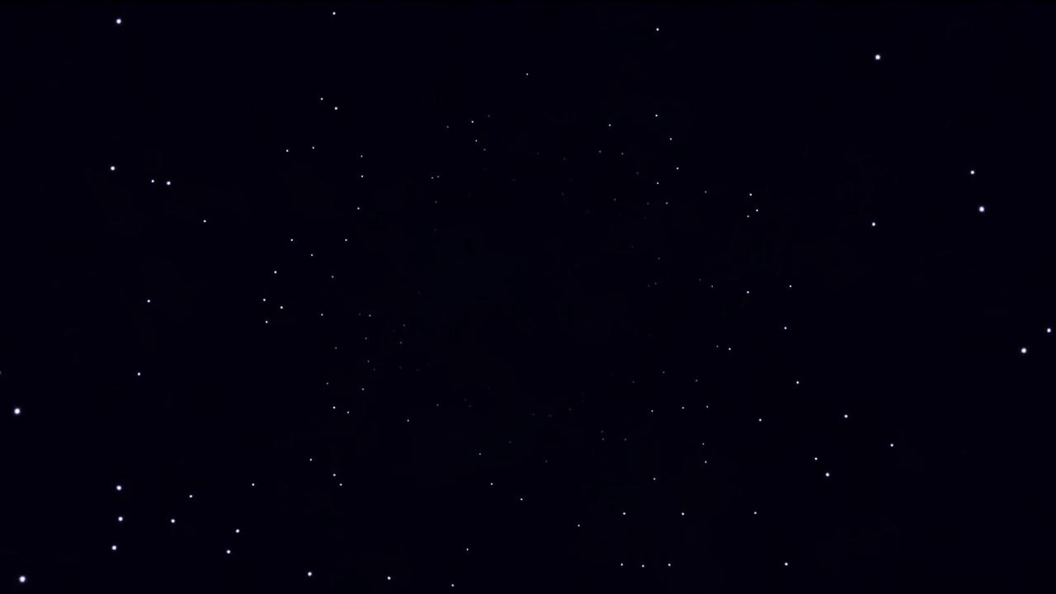
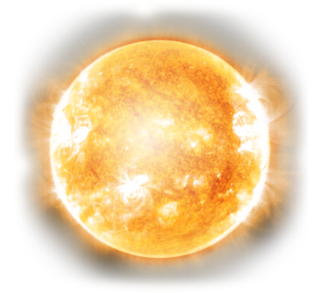

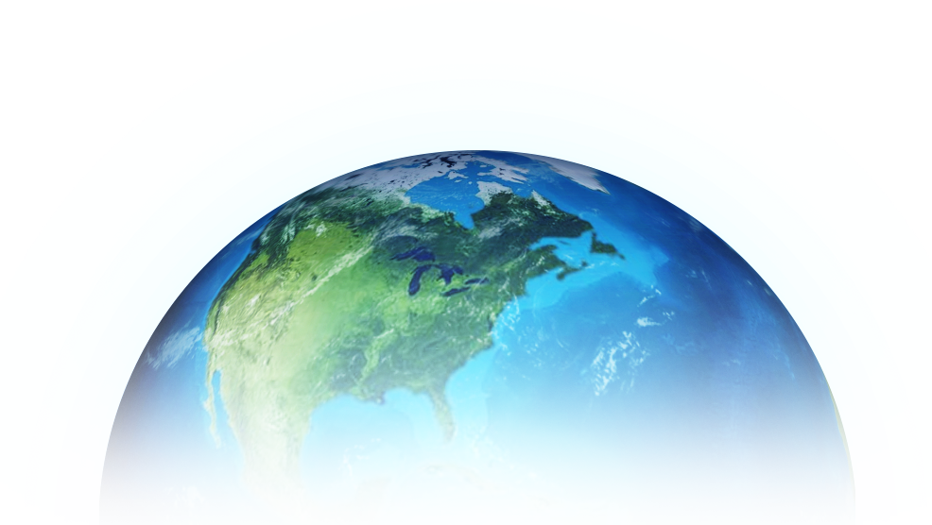
Different colours of sky
Minimum Scattering
Rays travel least distance

Slide 12
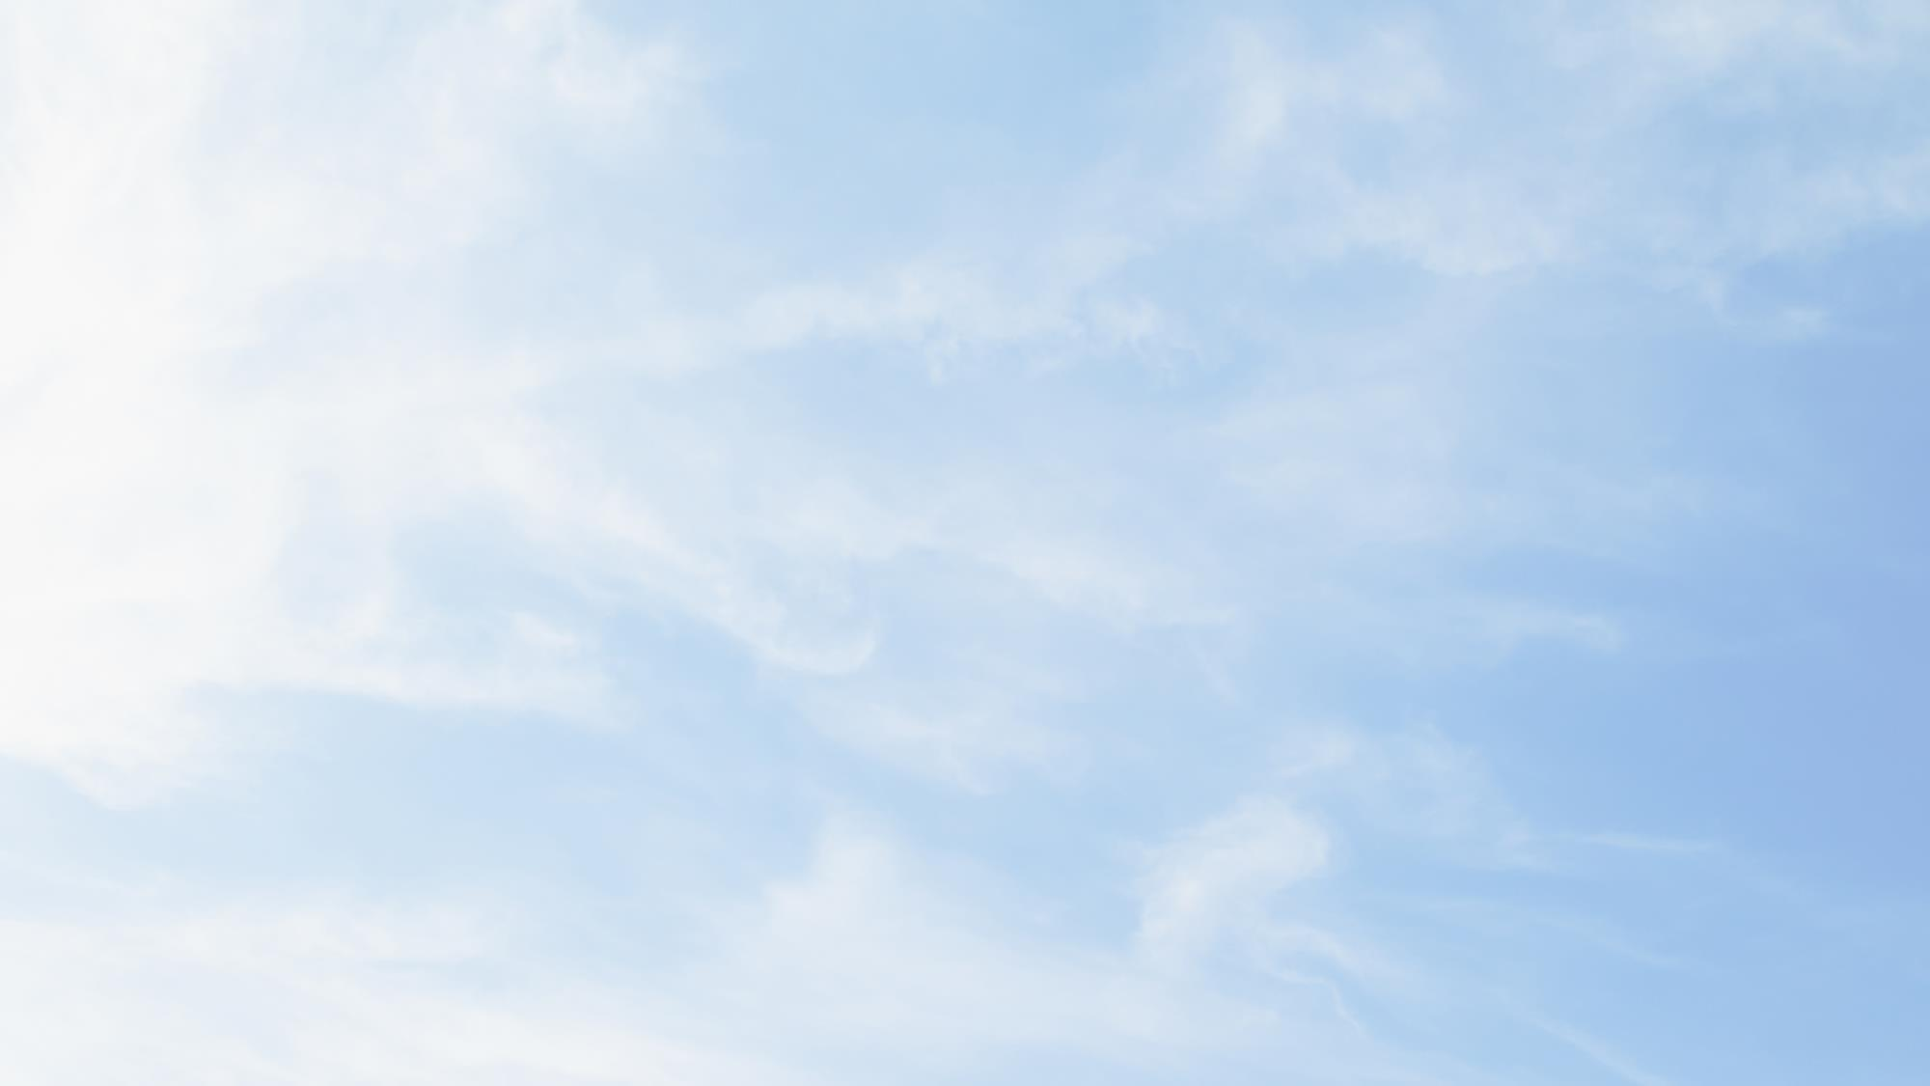
Different colours of sky
Minimum Scattering
Rays travel long distance
Rays travel least distance
More Scattering

Slide 13
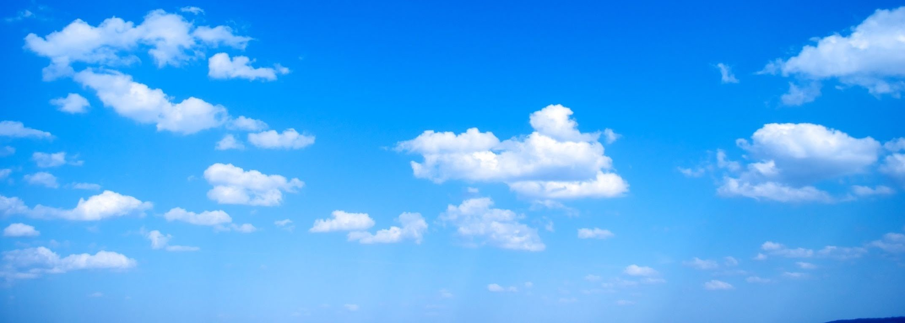
Different colours of sky
Red and Orange colour gets scattered least
Rays travel longest distance
Maximum Scattering

Slide 14
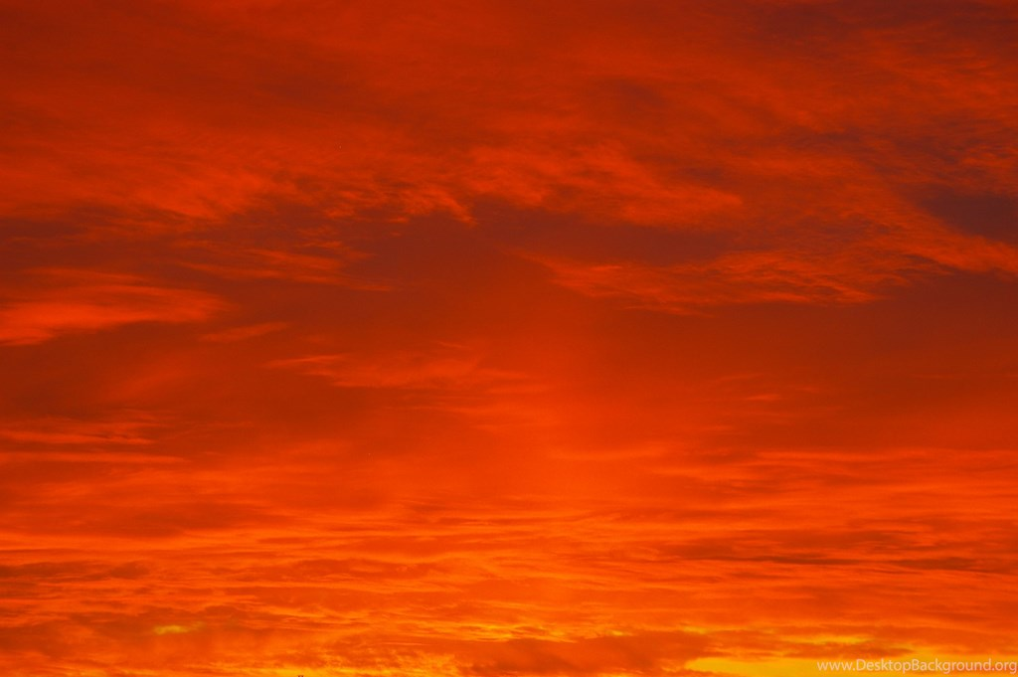
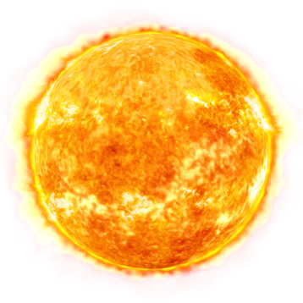
Different colours of sky

Slide 15
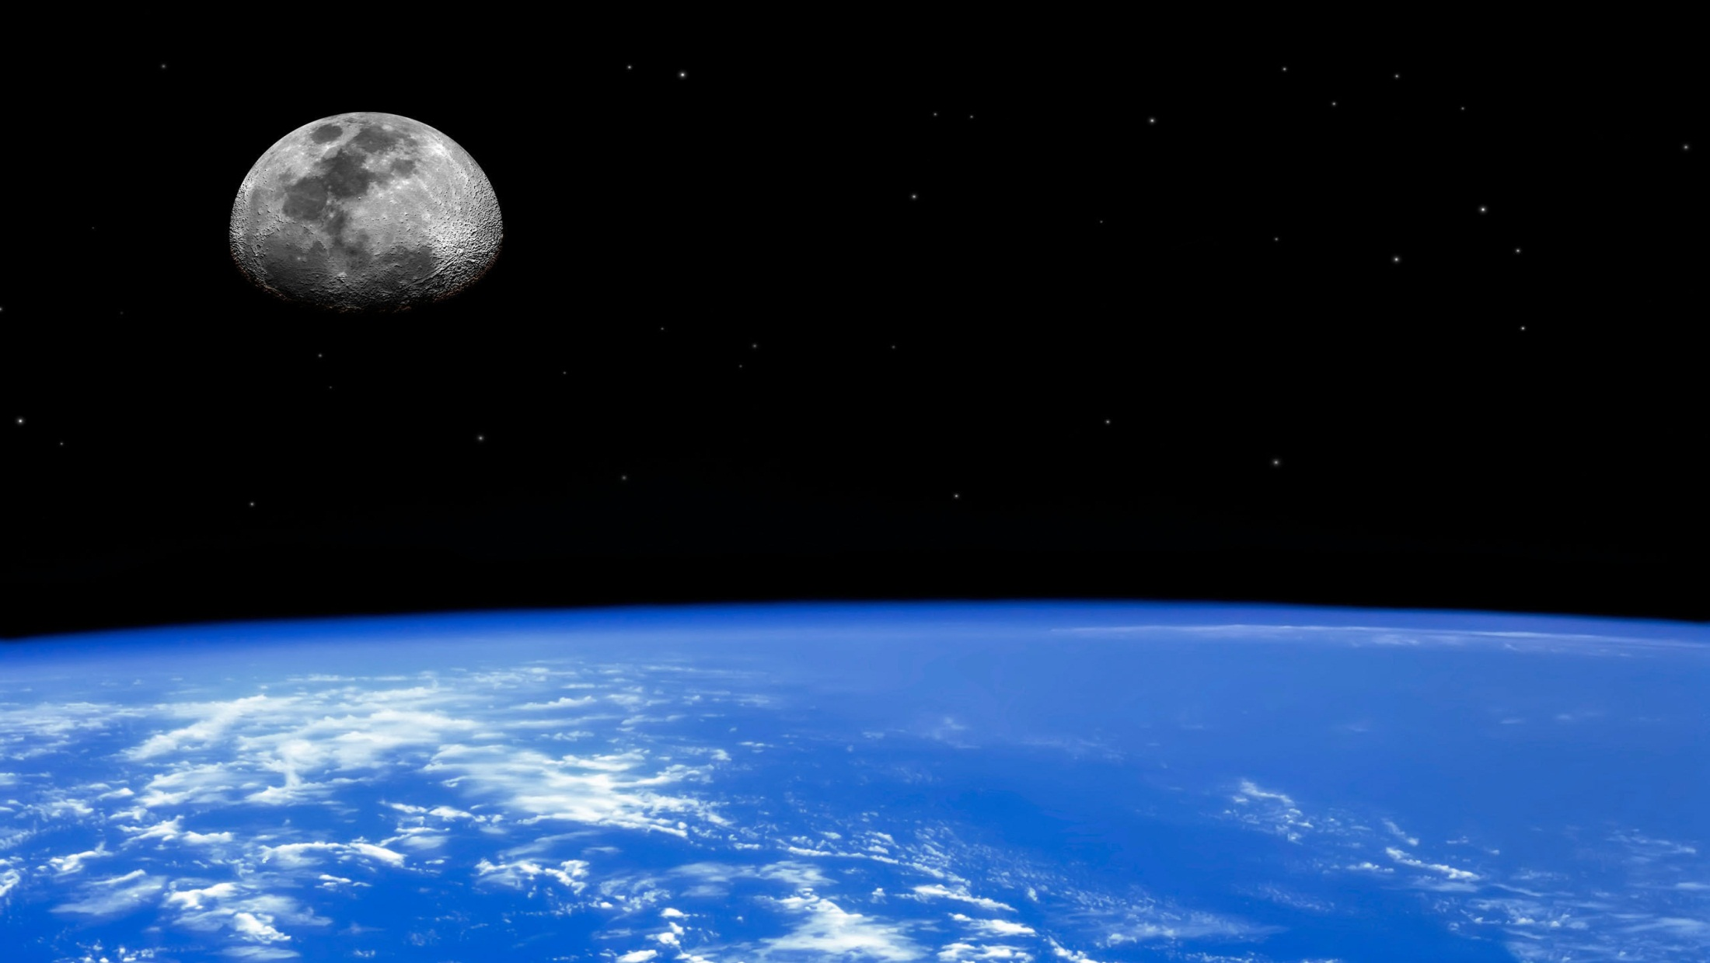
Colour of Sky in Space
No atmosphere
No scattering
No colour

Slide 16
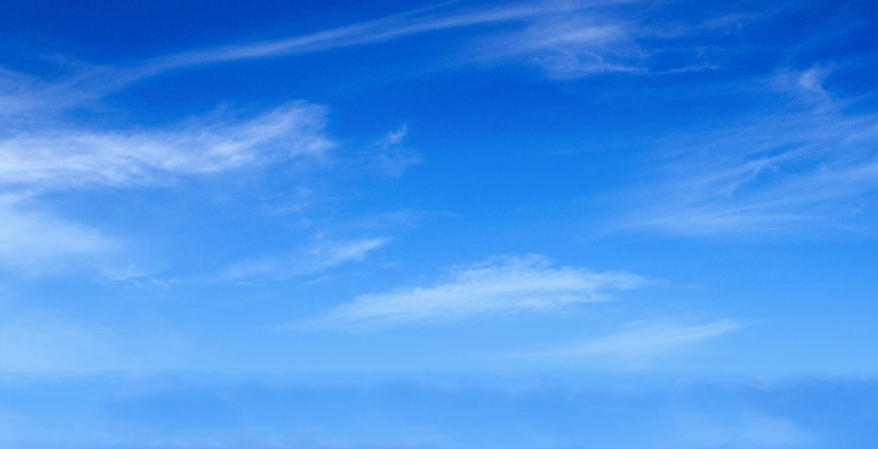

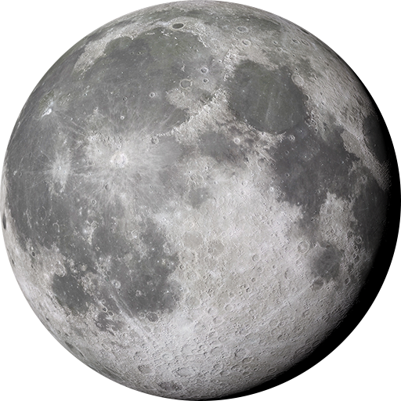
No atmosphere
No scattering
Space appears black

Slide 17
Thank You

